Slide 1
MINOR PROJECT – 2 (150603)
Abhinav Chaturvedi Sanidhya Somwanshi
0901CS191003 0901CS191107
CSE (3rd year- VI semester ) CSE (3rd year- VI semester )
Batch – A Batch – B

Slide 2
OPTIMAL LOCATION PREDICTOR

Slide 3
Project Description
Our Project is designed to help an individual to find an optimal place for the opening of a new restaurant.

Slide 4
Software Development Life Cycle Model
In this project we are going to follow rapid application development model for the development of this project.
Reason: since software size is not much large and there is a time bound and the project has to be made in modules therefore in this project, we are going to use RAD model.
A software project can be implemented using this model if the project can be broken down into small modules wherein each module can be assigned independently to separate teams. These modules can finally be combined to form the final product

Slide 5
Tools & Technologies
Python
Machine Learning
Visual Studio Code
Anaconda
Jupyter Notebook
Git & GitHub

Slide 6
Continued…
Geocoding
Reverse Geocoding
MapQuest API
Four Square API

Slide 7
Libraries Used
Numpy
Pandas
Matplotlib
Folium
Scikit-Learn
Pickle

Slide 8
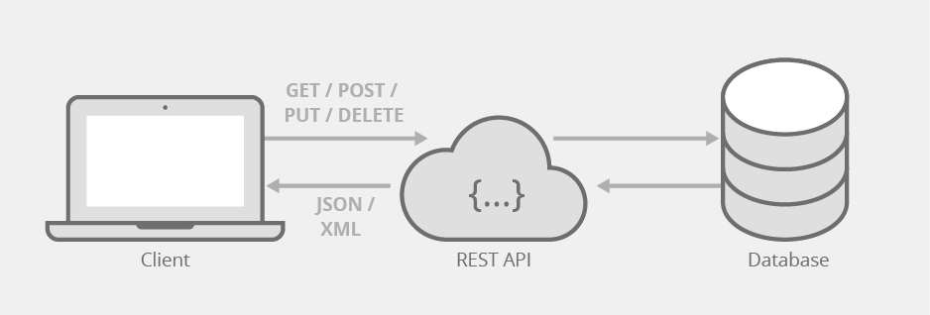
How API Works?

Slide 9
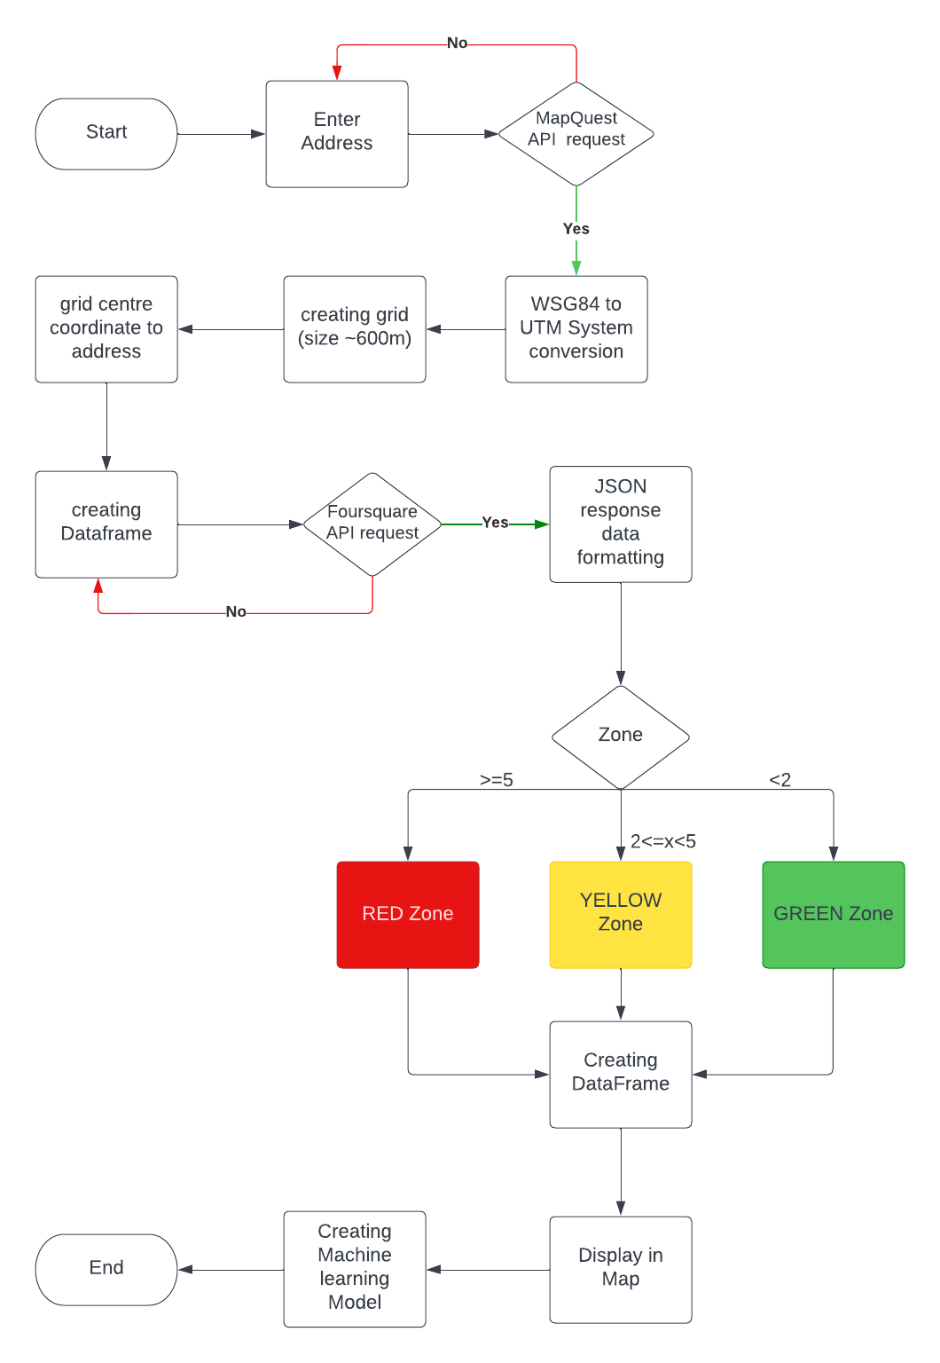
Data Flow Diagram

Slide 10
Data Flow Diagram

Slide 11
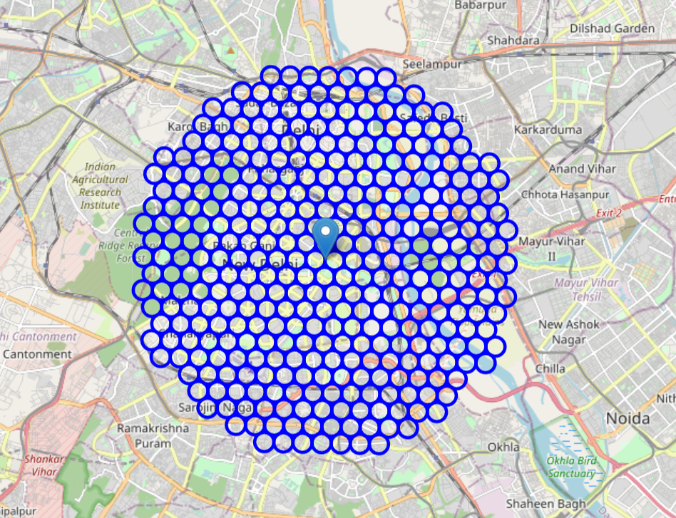
Creating Grids

Slide 12
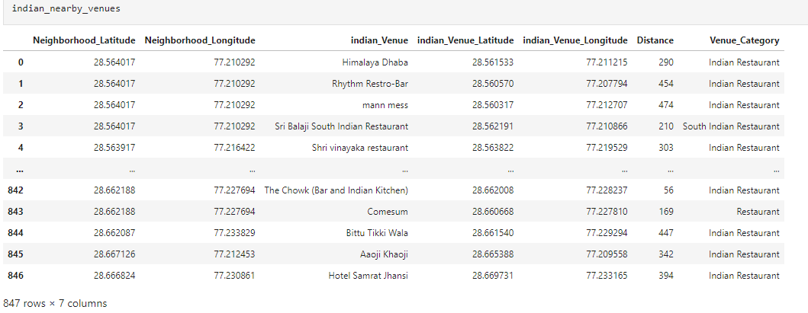
Nearby Venues Data

Slide 13
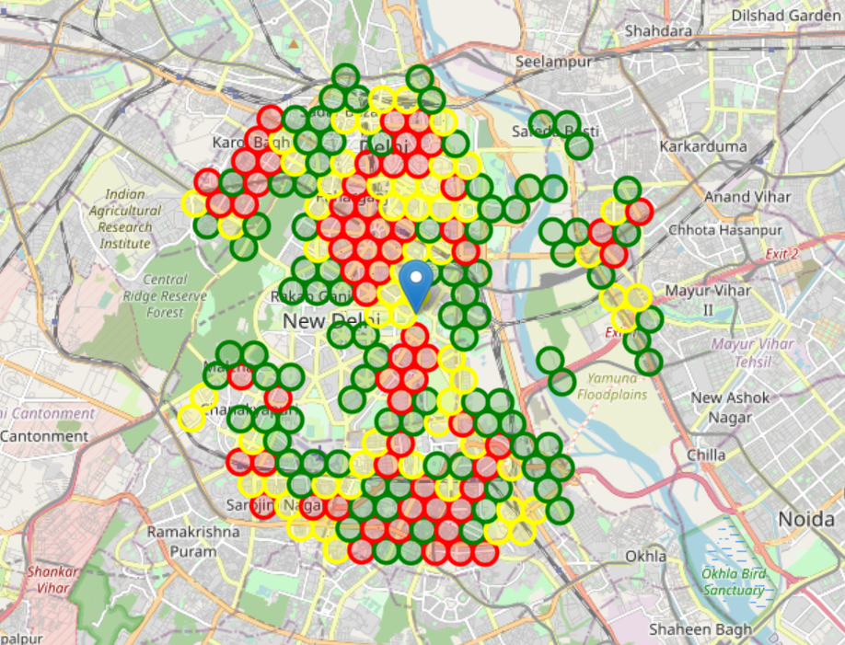
Result

Slide 14
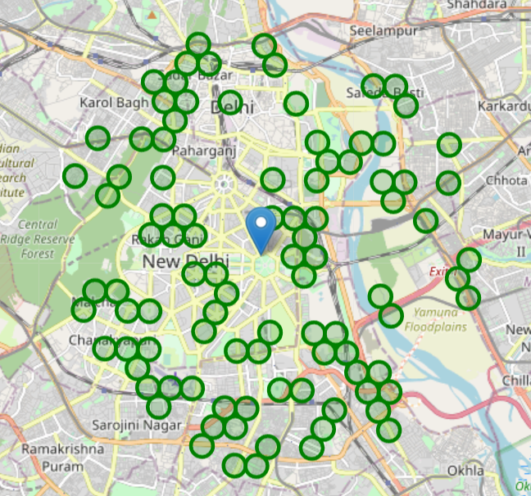
Result

Slide 15
Machine Learning Algorithm Used and Why?
Choosing a right Machine Learning algorithm to train the model is one of the most prominent step while developing an machine learning based project.
Here we are going to use Random Forest Classifier Algorithm
Reason: Random Forest Classifier is a type of supervised learning. It builds decision trees on different samples and takes their majority vote for classification.

Slide 16
Conclusion
There are some places that have a reasonable number of restaurants while some of them don’t have a single restaurant.
The Reason for this can be their demographic location, market attractiveness, etc.

Slide 17
Future Scope
We will try to enhance the dataset by including more cities (like Mumbai, Hyderabad, Pune, Bangalore, etc.)
We will try to build a user interface.
We will try to incorporate Restaurant Recommendation System based on Collaborative filtering.
We will try to improve our data analysis and prediction by adding more features like life expectancy, and customer reviews on the demographic location.
We will try to add a Customer review system for the pre-existing restaurants in that location which will help to build a community.

Slide 18
THANK YOU!!

Slide 19
References
1. Berumen Calderón, Mauro Felipe, Damayanti Estolano Cristerna, Angelica Selene Sterling Zozoaga, and Andreé Ricardo Berumen Calderón. "Model to assess the selection of the optimal location for a restaurant, a quantitative approach. Case study: Theme restaurants in Cancun, Mexico." Journal of Foodservice Business Research 24, no. 4 (2021): 457-501.
2. Hariharan, R., Arish Pitchai, and M. Dhilsath Fathima. "Prediction of Locations Using Unsupervised Learning Method to Open a Restaurant Branch." In Conference on Multimedia, Interaction, Design and Innovation, pp. 59-71. Springer, Cham, 2020.
3. Baksi, Bidisha Das, Varsha Rao, and C. Anitha. "A Survey on Local Market Analysis for a Successful Restaurant Yield." In Emerging Technologies in Data Mining and Information Security, pp. 249-257. Springer, Singapore, 2019.
4. Dock, Joel P., Wei Song, and Jia Lu. "Evaluation of dine-in restaurant location and competitiveness: Applications of gravity modeling in Jefferson County, Kentucky." Applied Geography 60 (2015): 204-209

